Slide 1

Foodcourt - Chatbot
DS606
Dr. Unal 'Zak' Sakoglu
12/11/2024
Team A - members:
Mounika Atmakuri
Sridhar Reddy Maram
Tauseef Taufiq K
Surya Teja Avvaru

Slide 2

Overview
Objective: Develop a chatbot to enhance the food-ordering experience in campus food courts.
Problem Statement: Manual food ordering is time-consuming, leading to inefficiencies and reduced customer satisfaction.
Solution: A virtual assistant chatbot providing real-time menu details, prices, nutritional information, and ingredients.
Technologies Used:
Dialogflow: For Natural Language Processing (NLP) and intent recognition.
FastAPI: Backend framework for API management and database connection.
MySQL: Storing menu data and managing queries.
Key Features:
Real-time information on food items and prices.
Streamlined food-ordering process, reducing workload for staff.
Future Goals: Expand chatbot capabilities to include order tracking, personalized recommendations, and multilingual support.

Slide 3

Dataset Overview
Source:
Data collected Manually and from UMBC Dining Website and expanded using Python web scraping.
Categories:
Items grouped into sandwiches, drinks, desserts, and meal deals.
Attributes:
Includes name, category, price, nutritional info, and availability.
Dataset Size:
Around 150 menu items.
Data Cleaning:
Addressed missing data, removed duplicates, and standardized formats.
Data Storage:
Stored in a MySQL database for chatbot integration.

Slide 4
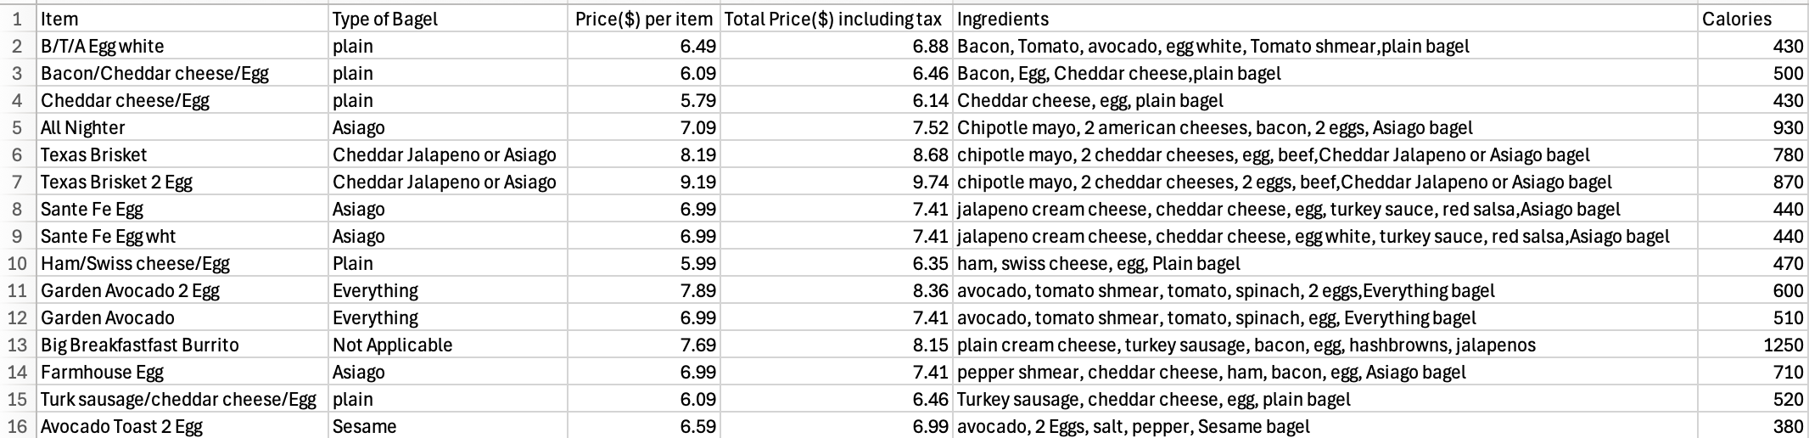
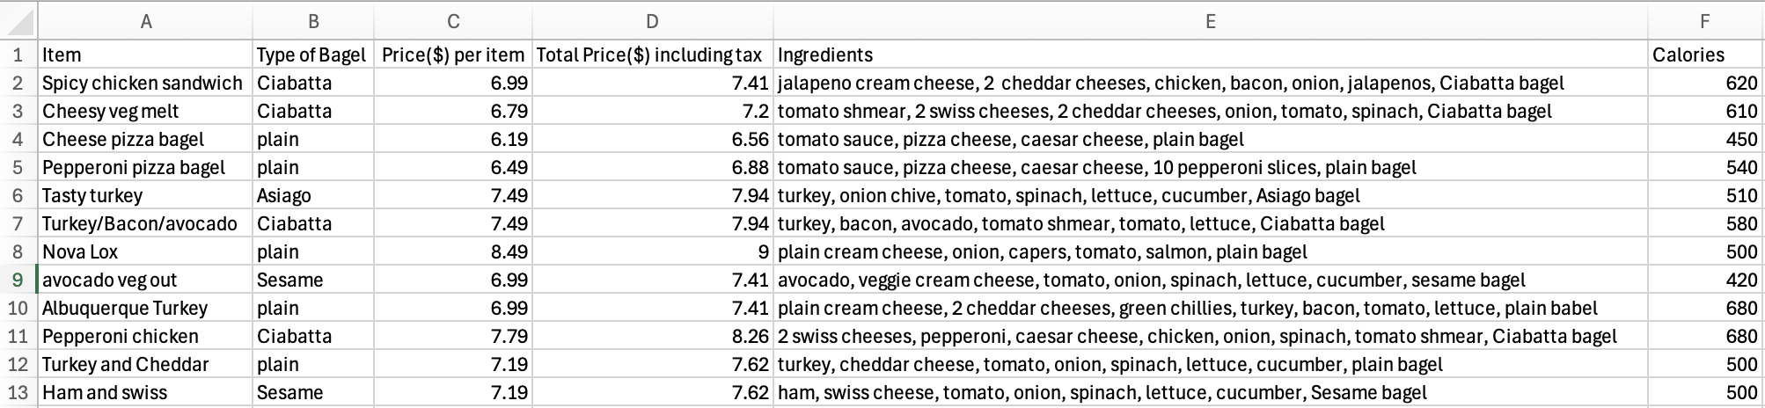
SAMPLE DATASETS

Slide 5

Literature Overview
Advancement in Chatbot Technology:
Transition from rule-based chatbots (e.g., ELIZA) to AI-powered systems that are capable of understanding
natural language and context using technologies like Dialogflow.
Dialogflow as the NLP Engine:
Dialogflow simplifies intent detection, entity extraction, and conversational flow management, making
it an ideal choice for developing user-interactive chatbots.
FastAPI for Backend Integration:
FastAPI provides a high-performance, asynchronous framework to handle webhook requests, process
user intents and interact with databases efficiently.
MySQL for Data Storage:
MySQL offers a reliable relational database system for storing and querying structured data like menu items,
prices, ingredients, and nutritional information.
Real-Time Query Handling:
The integration of Dialogflow, FastAPI, and MySQL enables real-time responses to complex user queries such
as price filtering, ingredient lookup, and nutritional analysis.

Slide 6
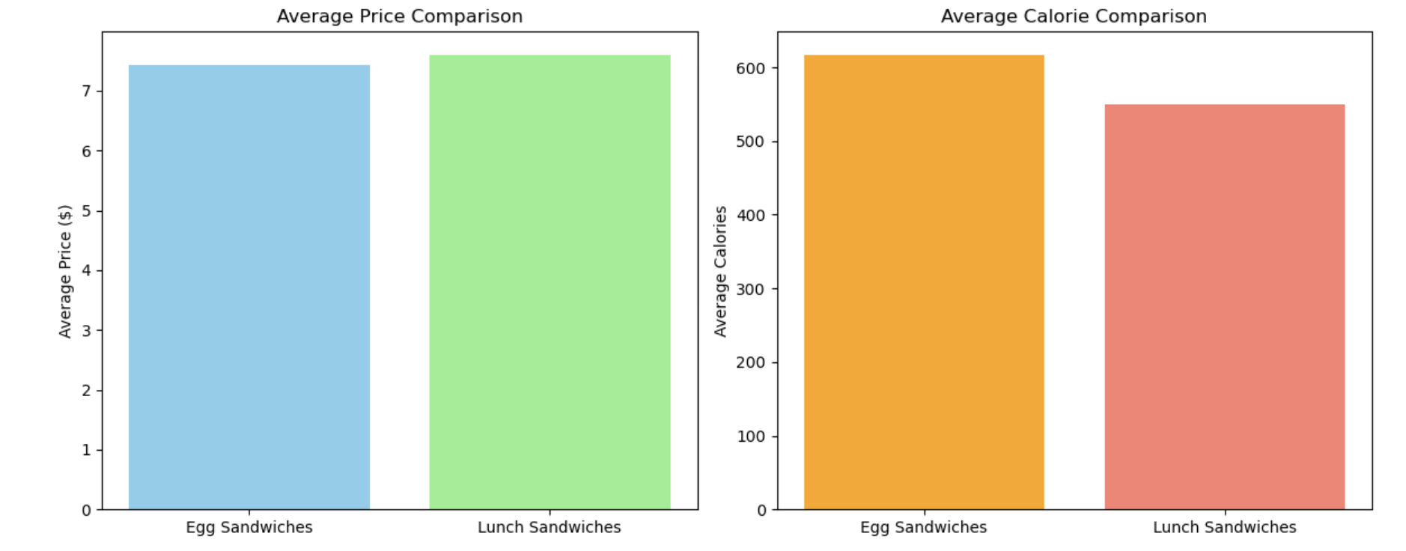
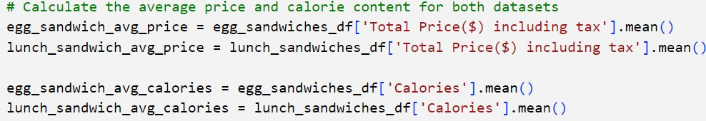
Exploratory Data Analysis [EDA]

Slide 7
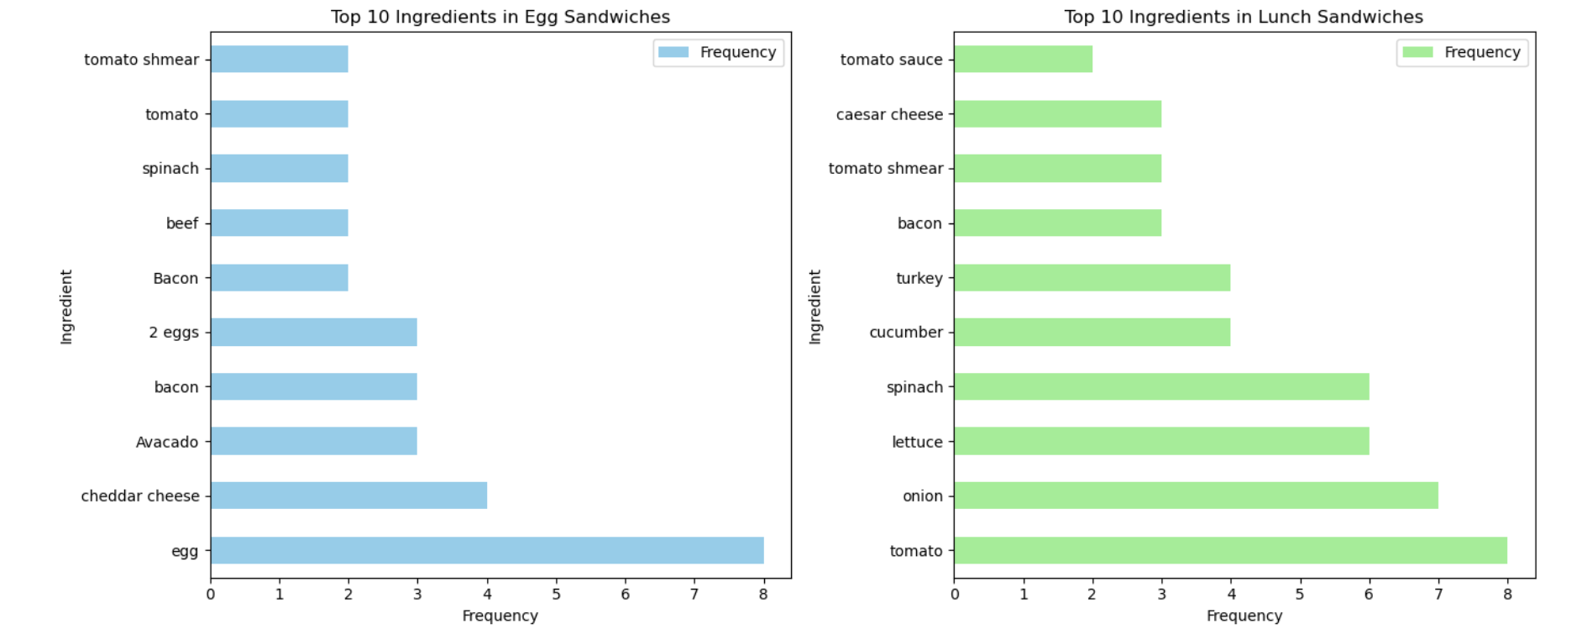
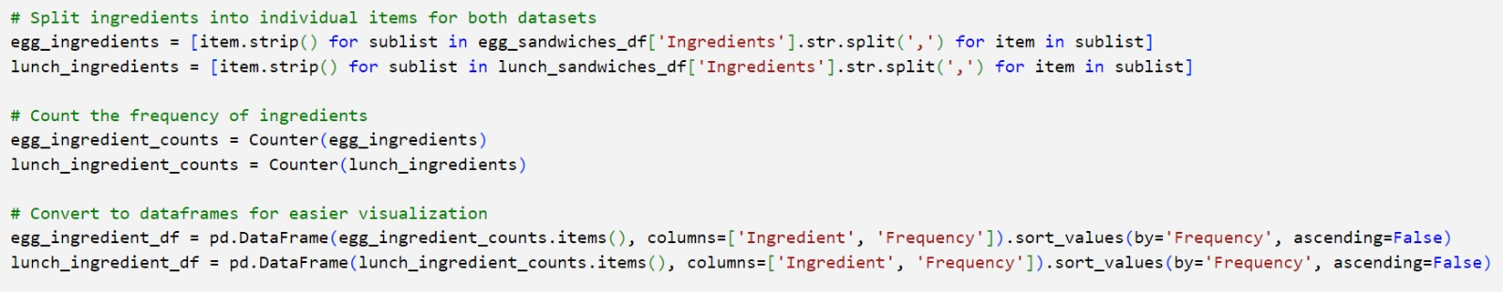
Exploratory Data Analysis [EDA]

Slide 8
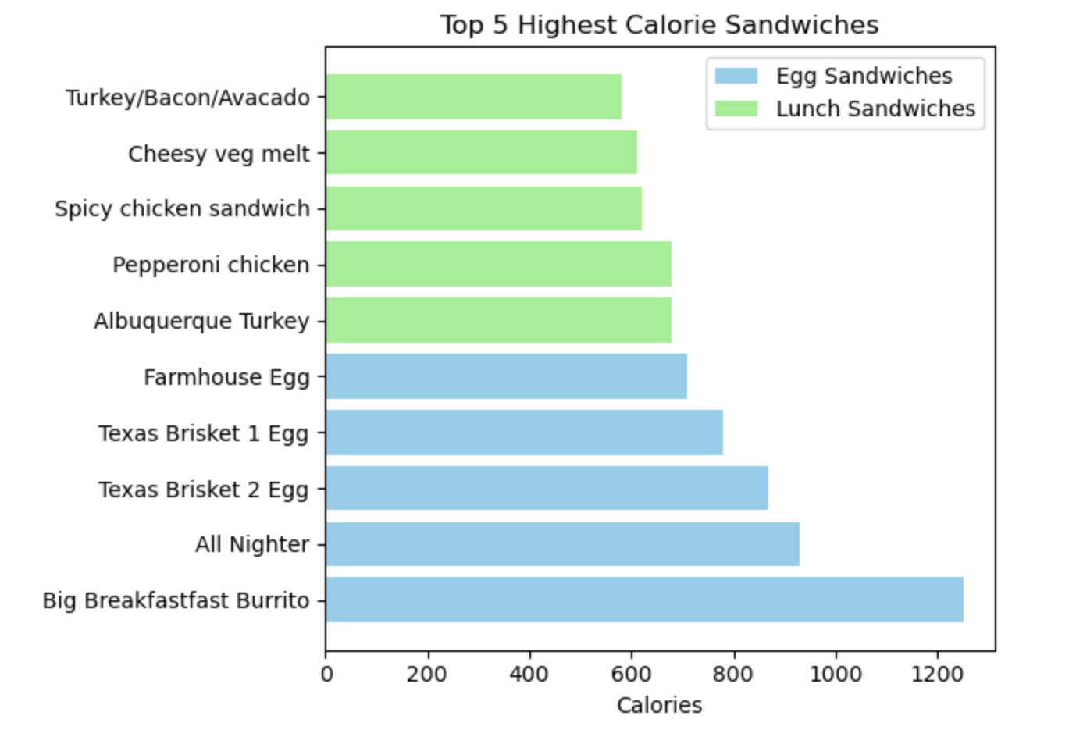
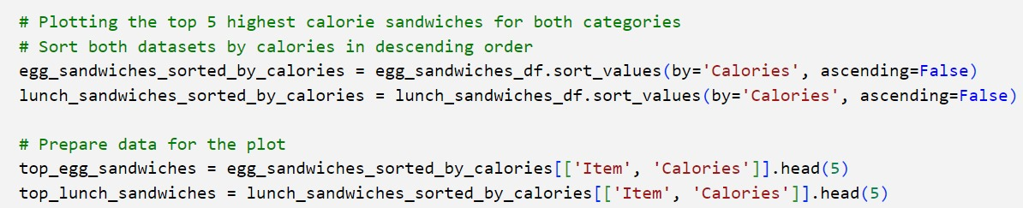
Exploratory Data Analysis [EDA]

Slide 9
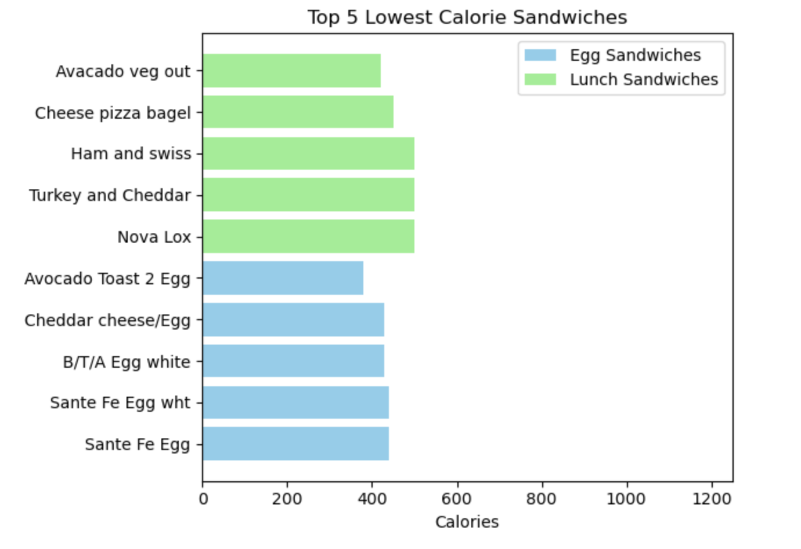
Exploratory Data Analysis [EDA]

Slide 10
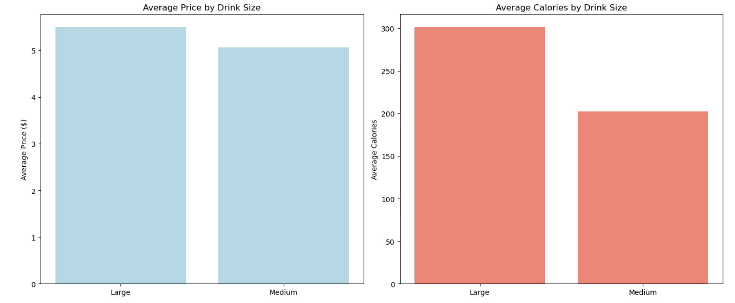
Exploratory Data Analysis [EDA]

Slide 11
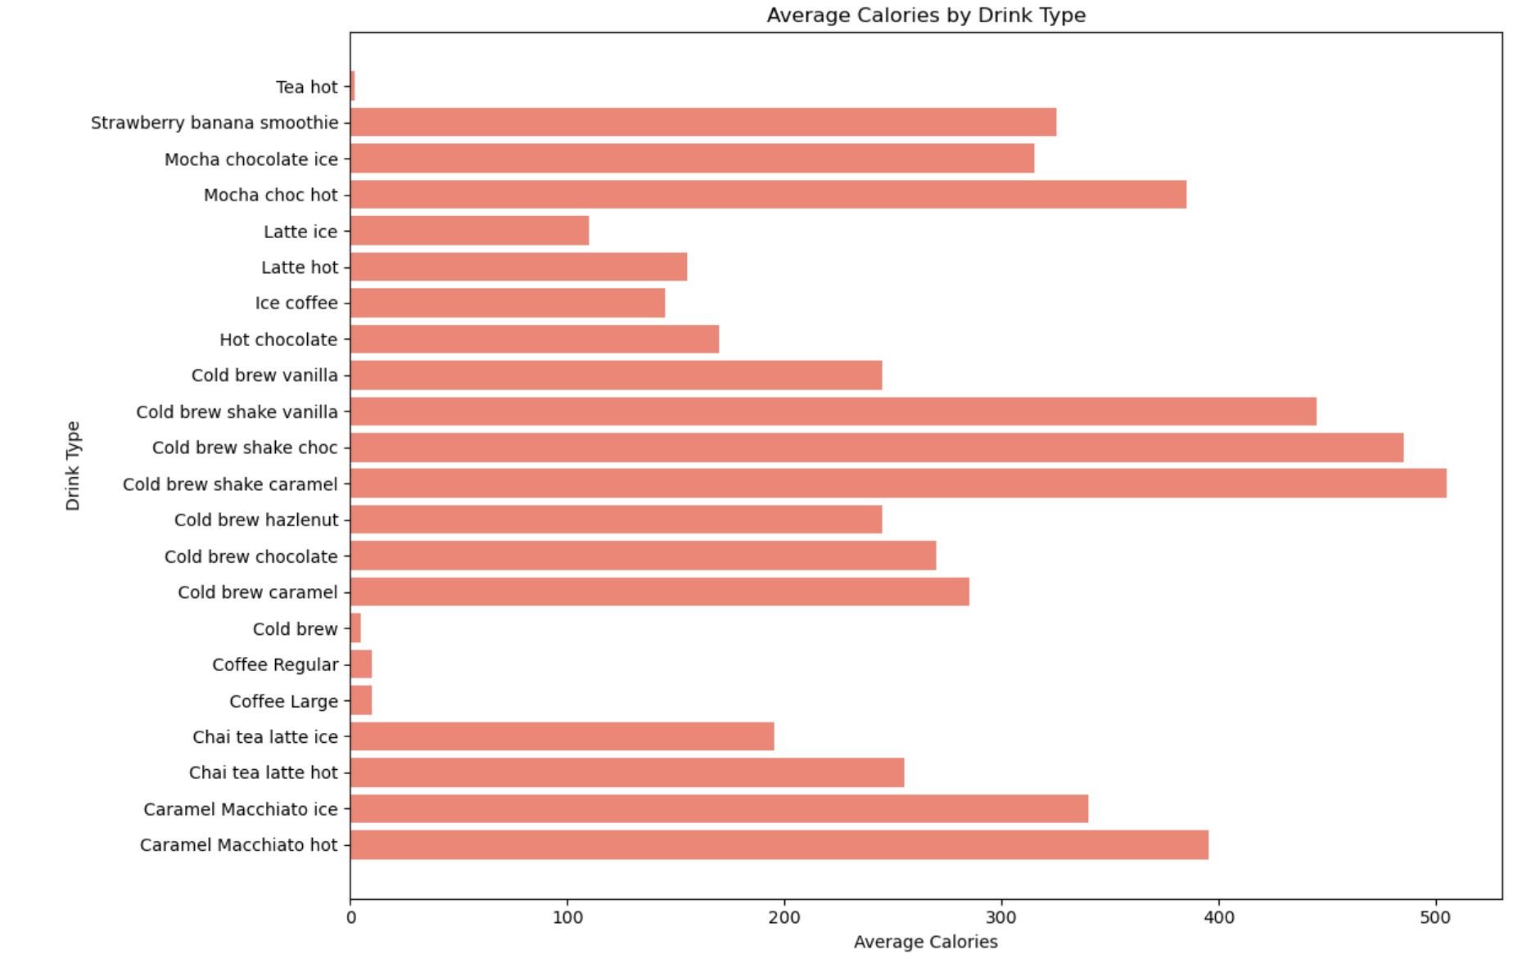
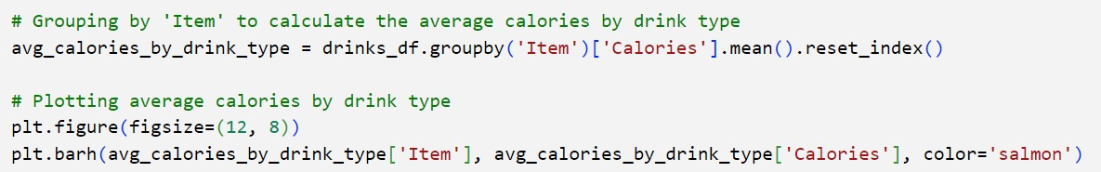
Exploratory Data Analysis [EDA]

Slide 12

Methodology
User Query: Users interact with the chatbot via web inteface, which sends their input (e.g., "What’s on the menu?") to Dialogflow for intent recognition.
Dialogflow: Processes the query, identifies the intent (e.g., menu inquiry), extracts entities, and triggers a webhook request if additional data is required.
FastAPI Backend: Receives the webhook request, applies business logic, and queries the MySQL database for relevant information.
MySQL Database: Stores menu data (e.g., categories, prices, nutritional info) and provides requested details to the backend.
Response to User: FastAPI formats the response, sends it to Dialogflow, and displays it on the Streamlit interface (e.g., "Available drinks: Coffee, Tea, Soda").
Feedback and Updates: Logs from Dialogflow are analyzed for improvements, and the database is updated in real-time using web scraping to ensure accuracy.

Slide 13

Model Architecture
NLP Platform: Dialogflow
Recognizes user intents (e.g., menu inquiries, price checks, and nutritional info requests).
Extracts entities such as food items and categories.
Handles conversational flow and fallback responses for unrecognized queries.
Backend Framework: FastAPI
Processes webhook requests from Dialogflow.
Queries the MySQL database for real-time data retrieval.
Database: MySQL
Stores structured data such as food item names, prices, categories, and nutritional details.

Slide 14

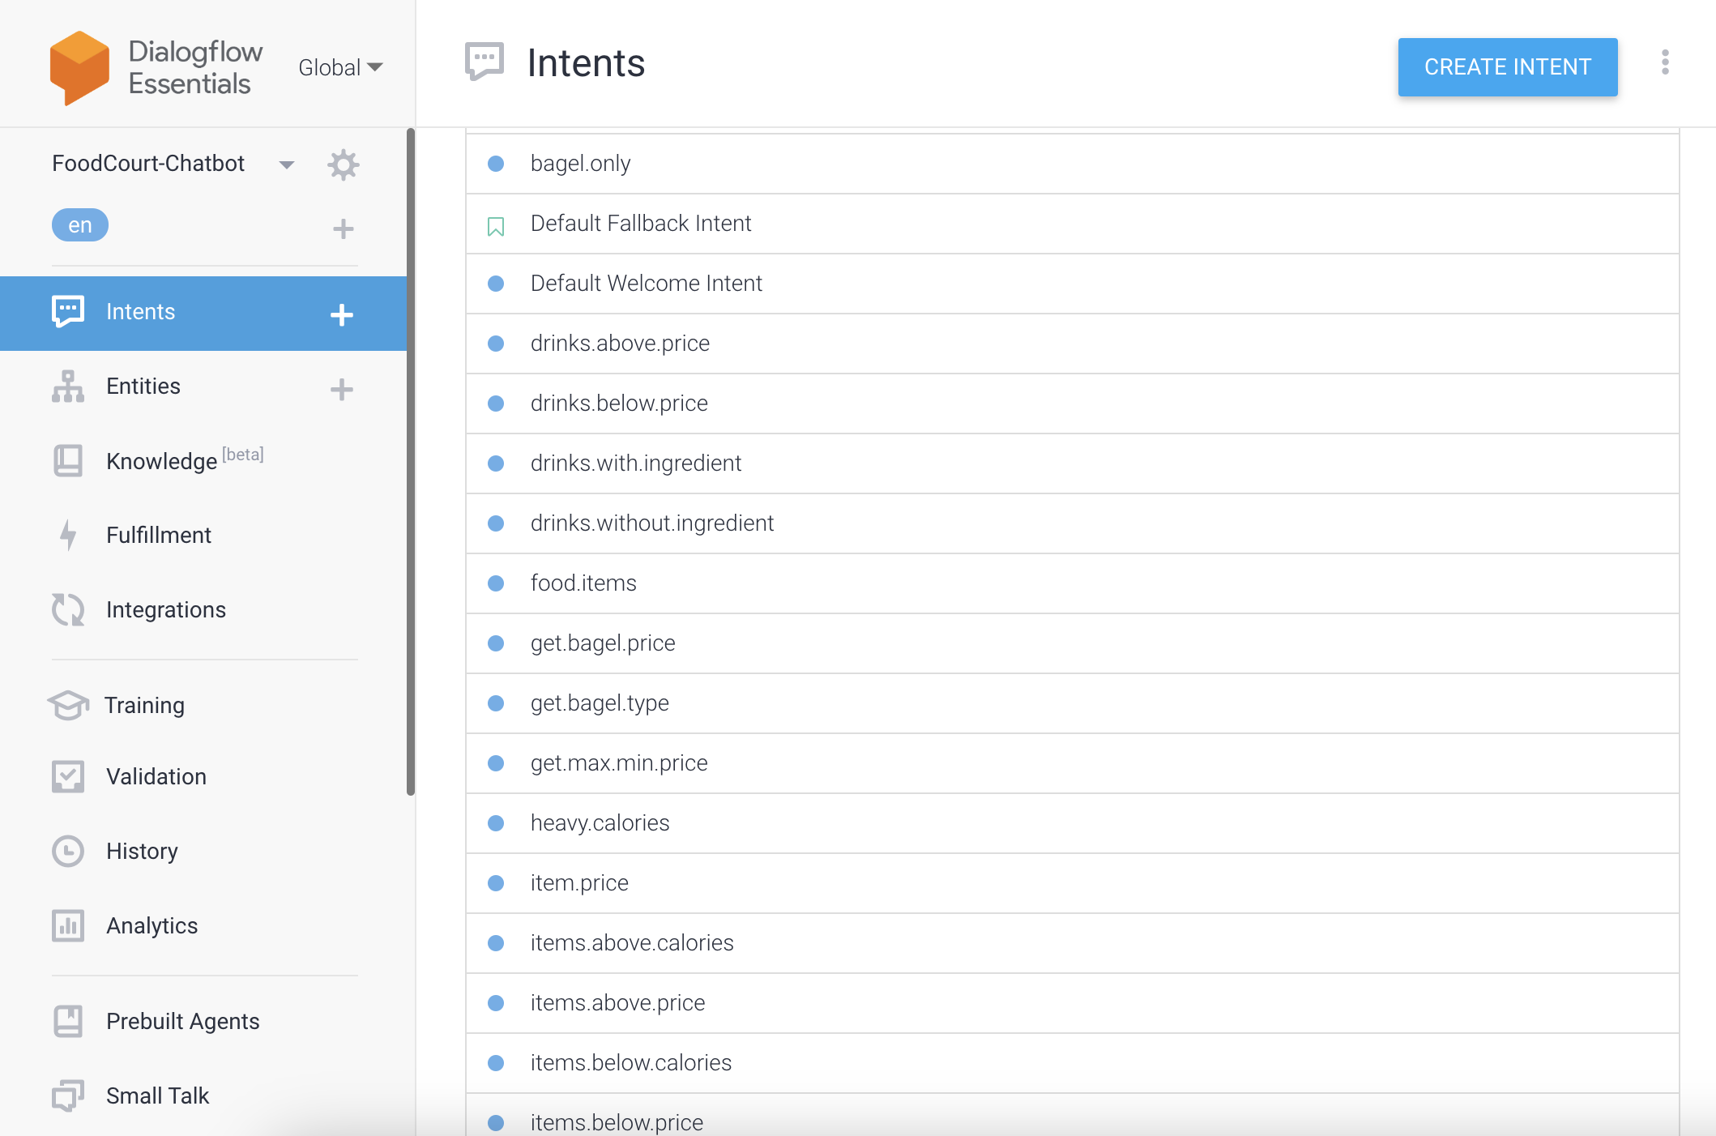
INTENTS IN DIALOGFLOW

Slide 15
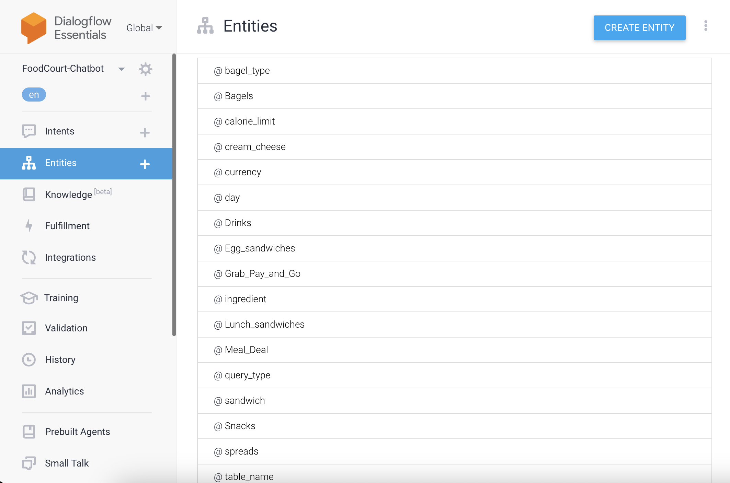
ENTITIES IN DIALOGFLOW

Slide 16
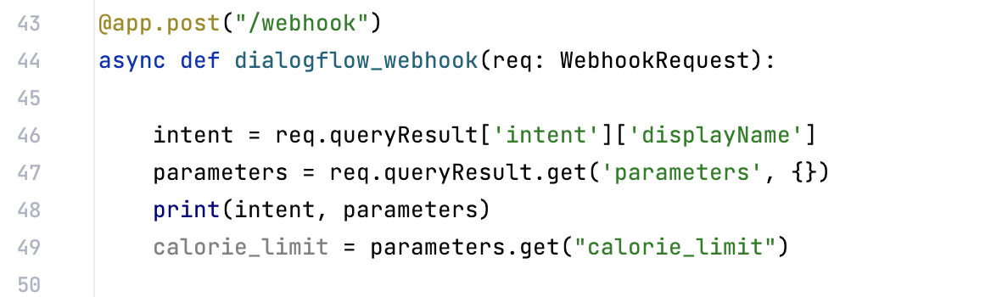
Webhook endpoint to process Dialogflow requests using FastAPI

Slide 17
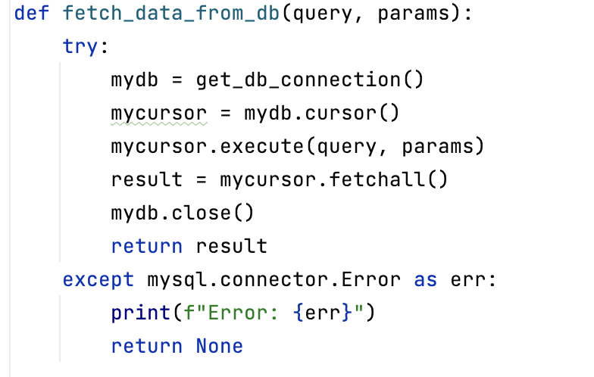
Fetch data from MySQL using FastAPI

Slide 18
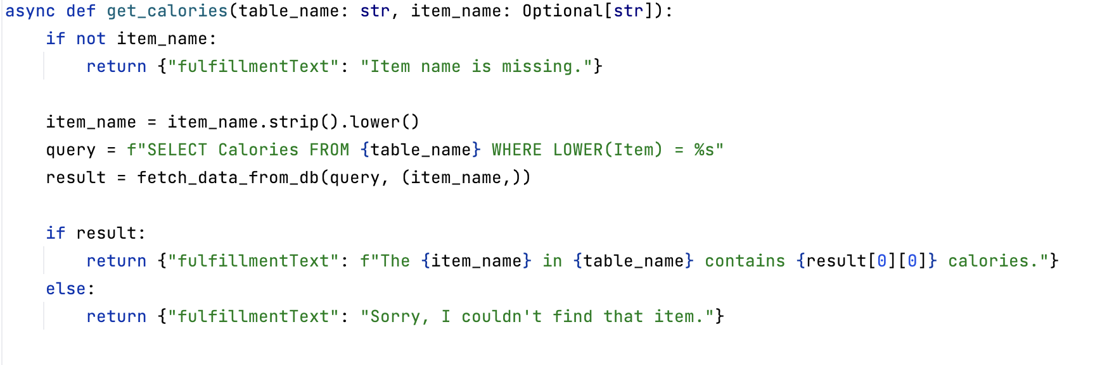
SQL query in FastAPI

Slide 19
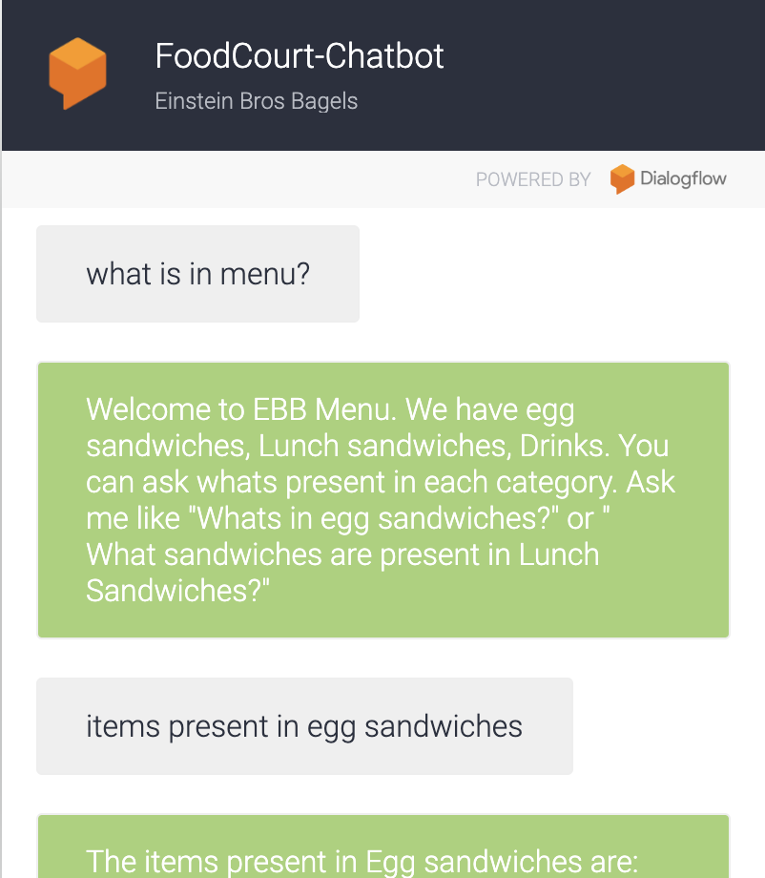
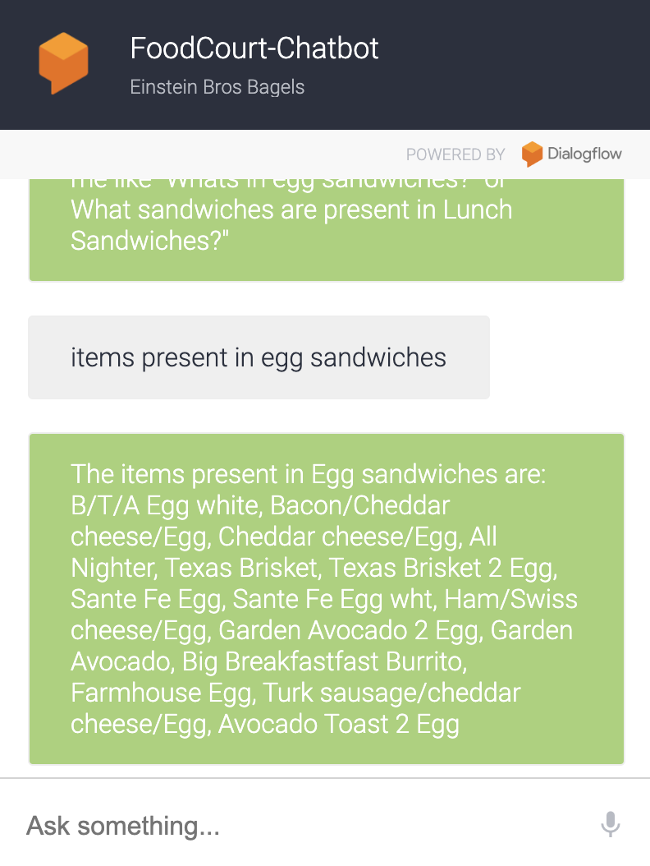

Slide 20
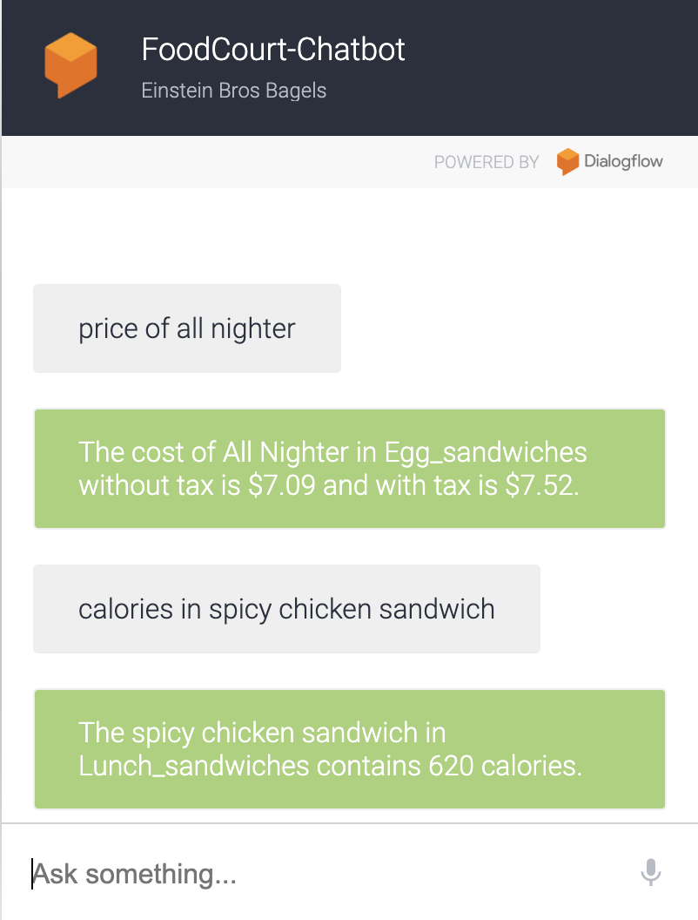
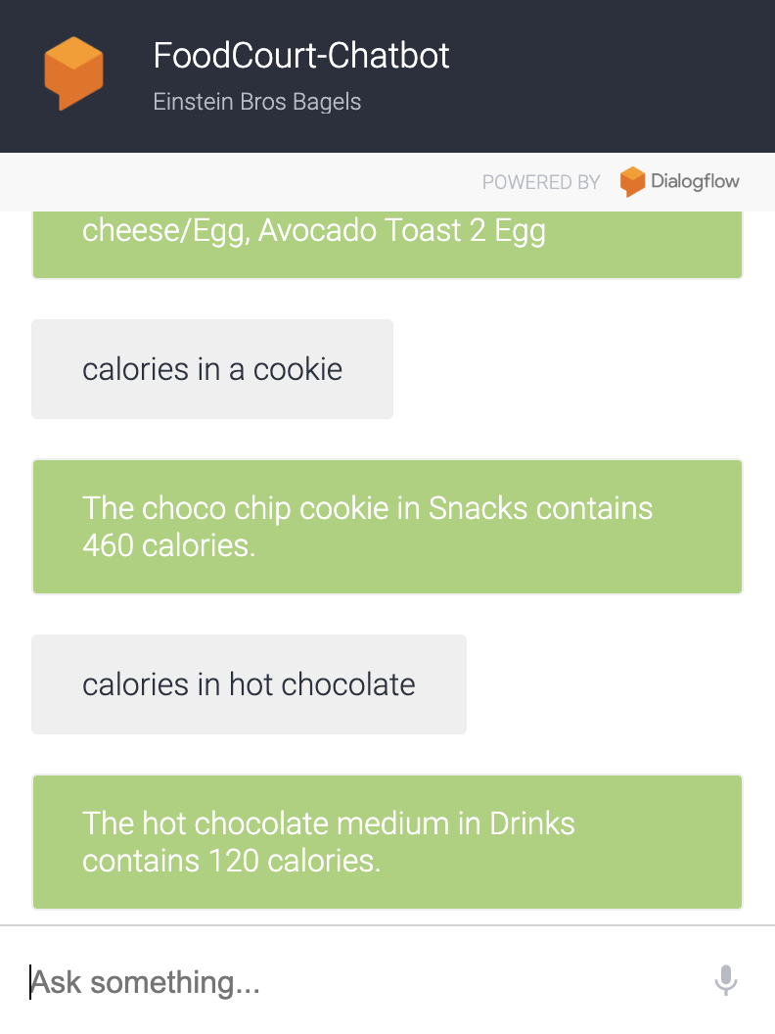

Slide 21
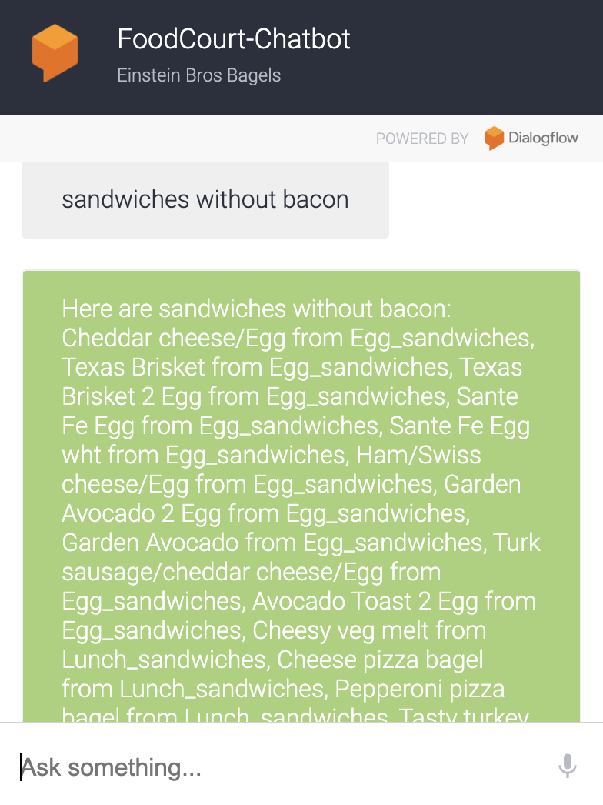
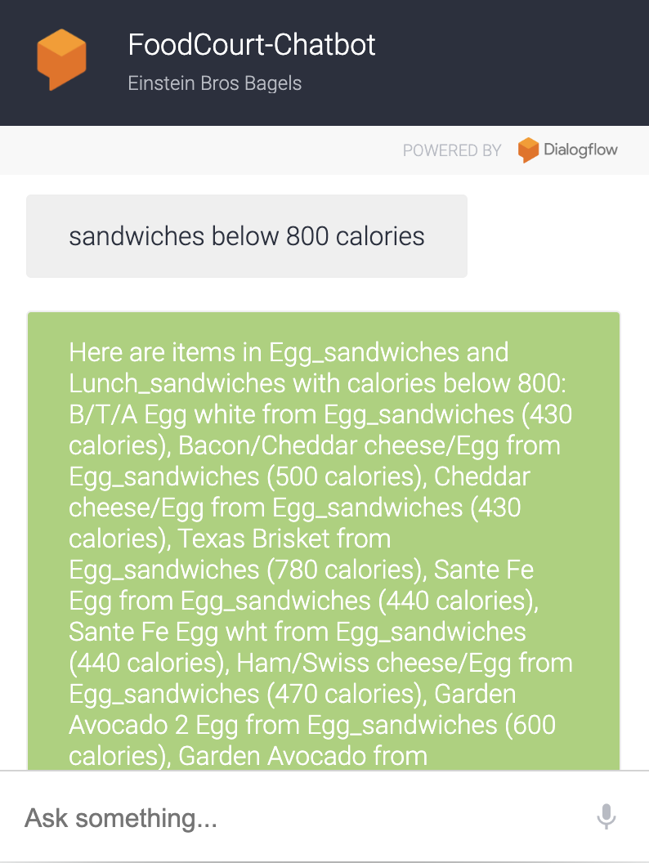

Slide 22
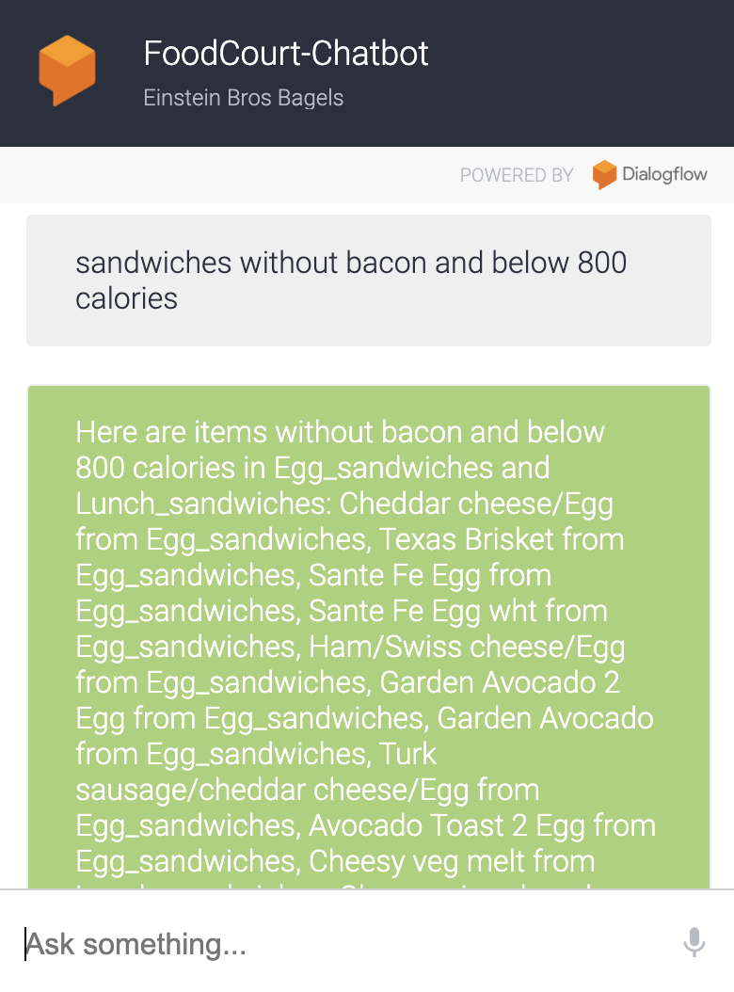
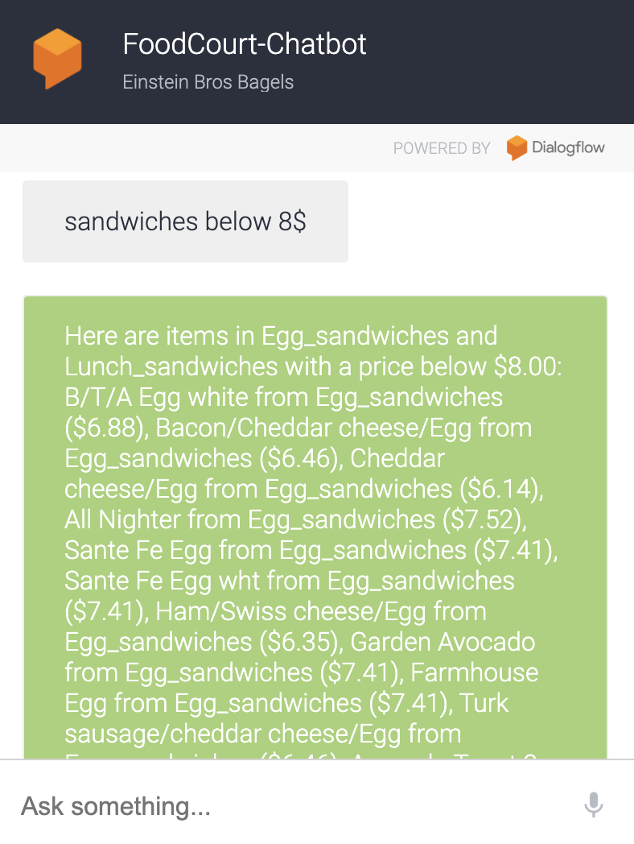

Slide 23
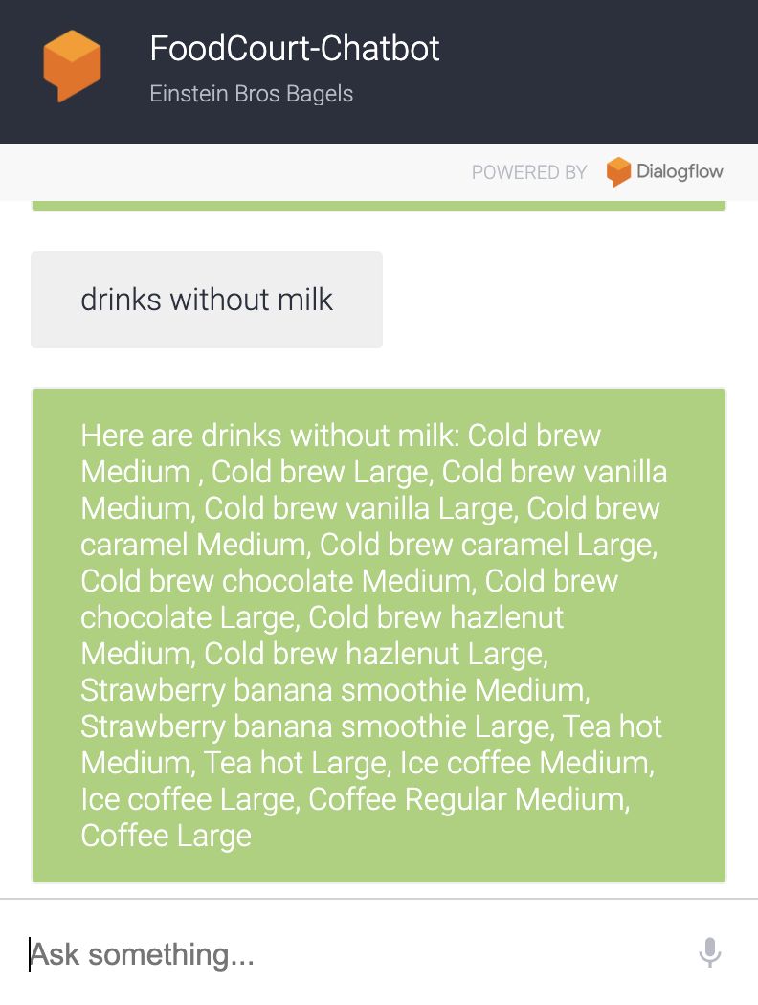
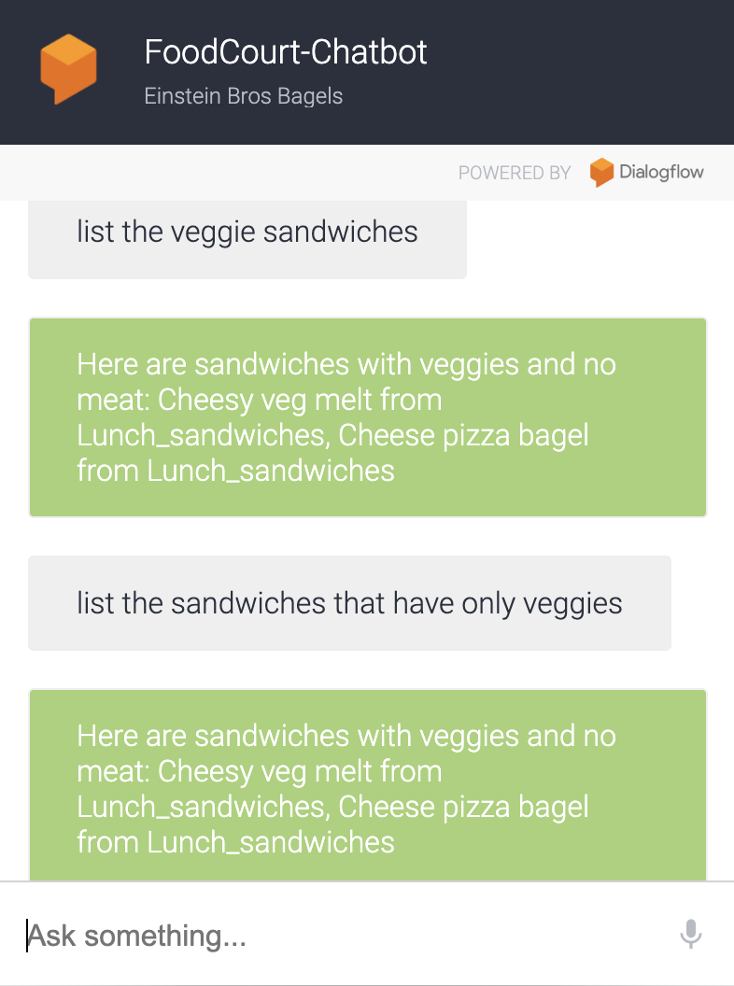

Slide 24
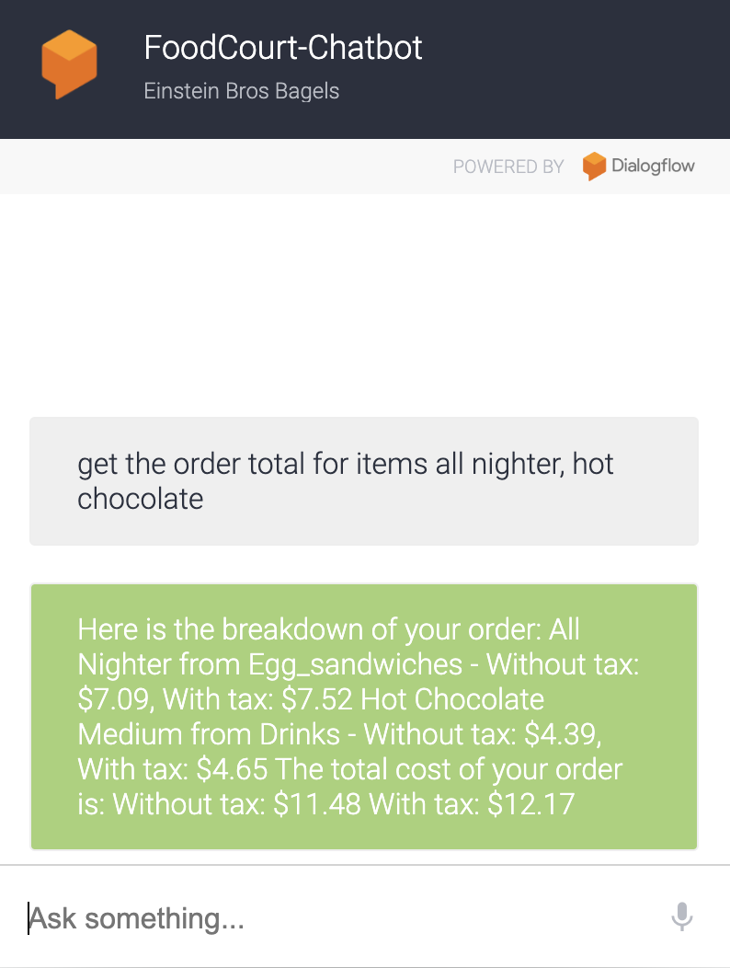
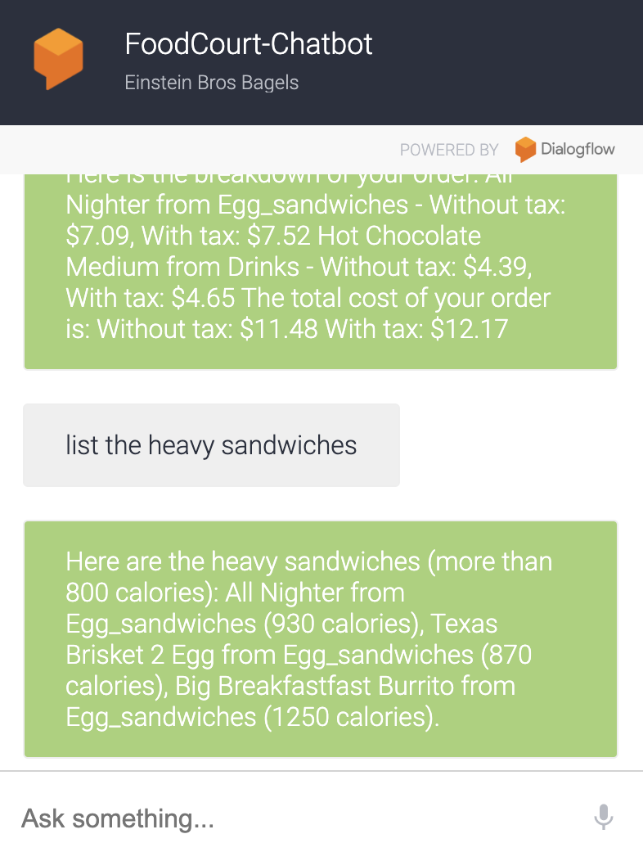

Slide 25

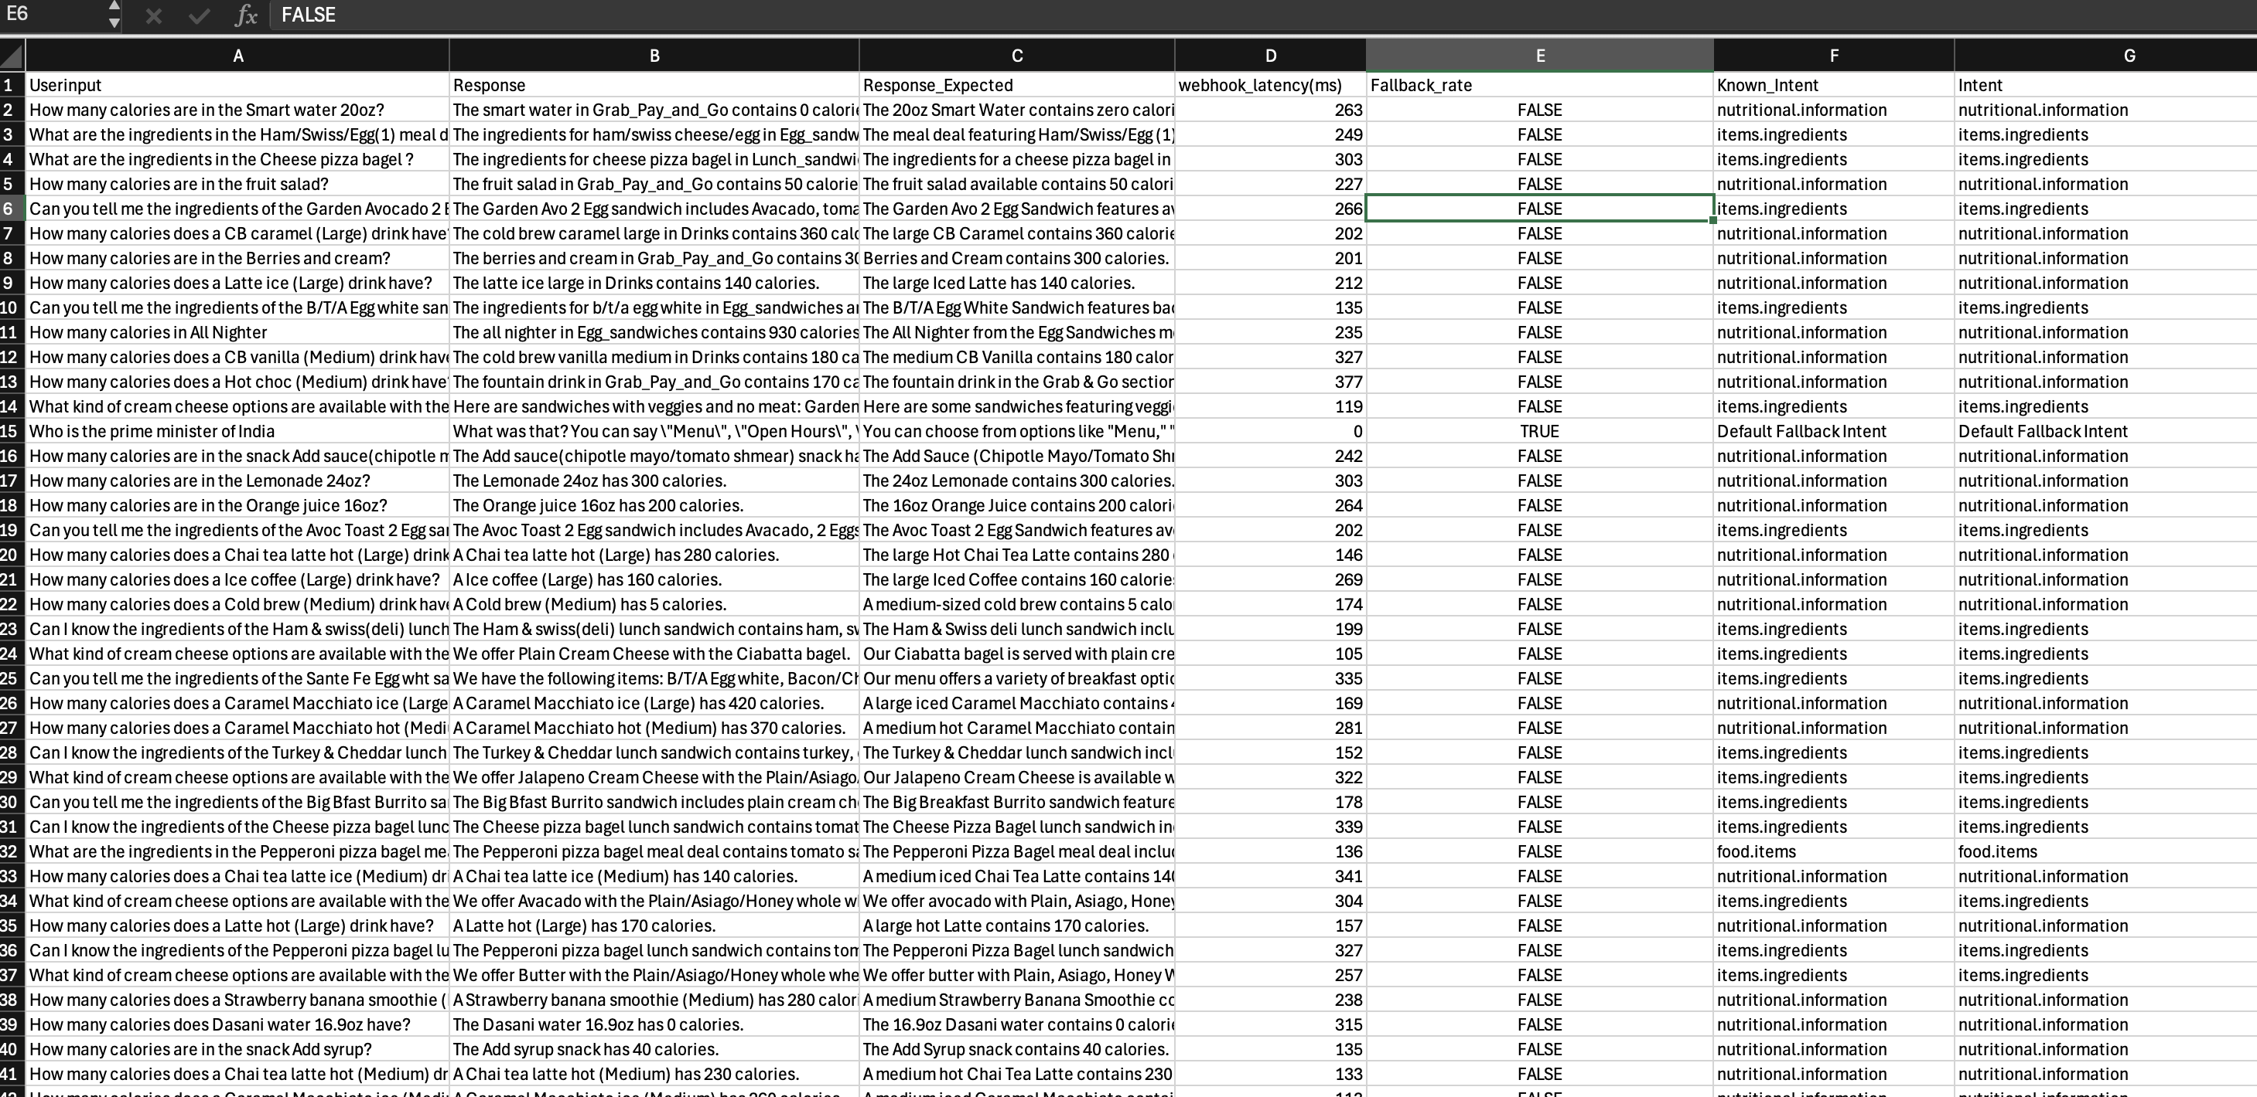
Results and Performance

Slide 26
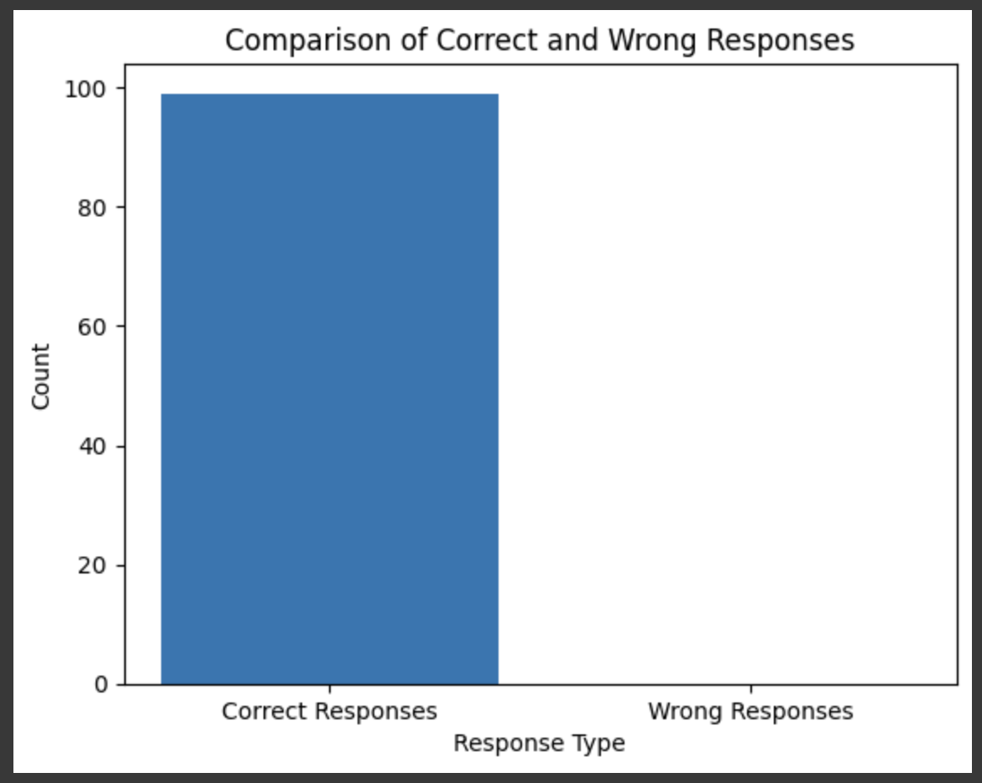
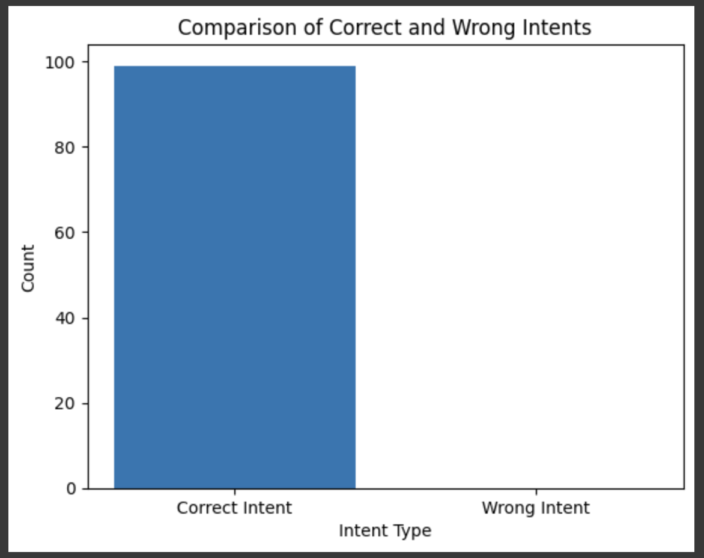
Results and Performance
Task Success Rate: Out of 100 simulated queries, the chatbot successfully resolved all 100 tasks, showcasing its high reliability in handling a diverse range of user queries.
Intent Classification Accuracy: The chatbot correctly identified user intents in 100 out of 100 cases, showcasing its ability to understand natural language inputs.

Slide 27
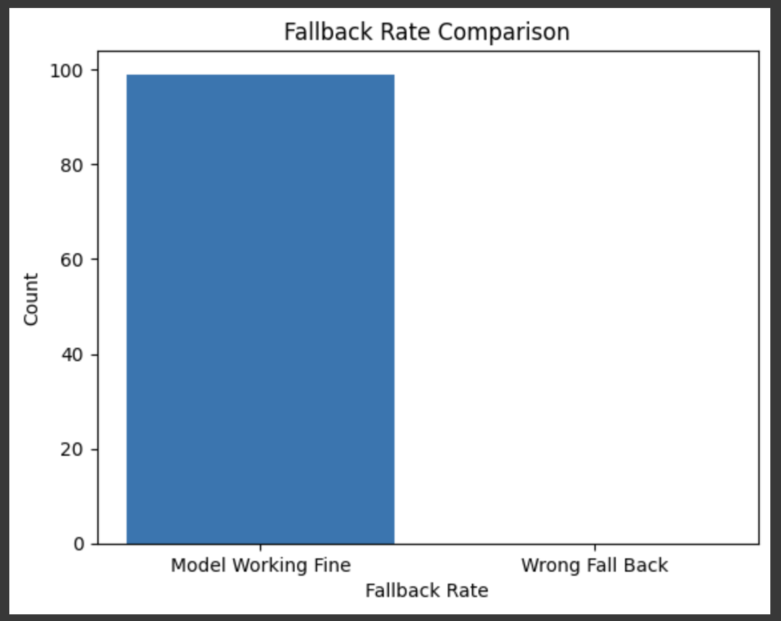
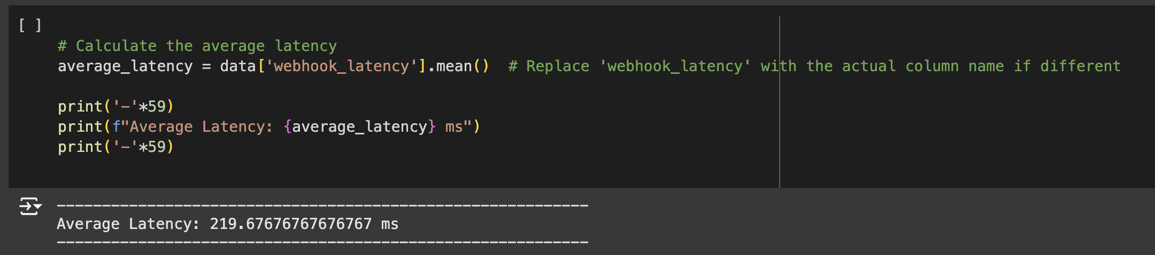
Results and Performance
Fallback Rate: Fallback responses were triggered in none of the cases [0% of cases], indicating minimal confusion in handling queries.
Response Time: The chatbot consistently responded in under 0.5 second, ensuring a seamless user experience.

Slide 28

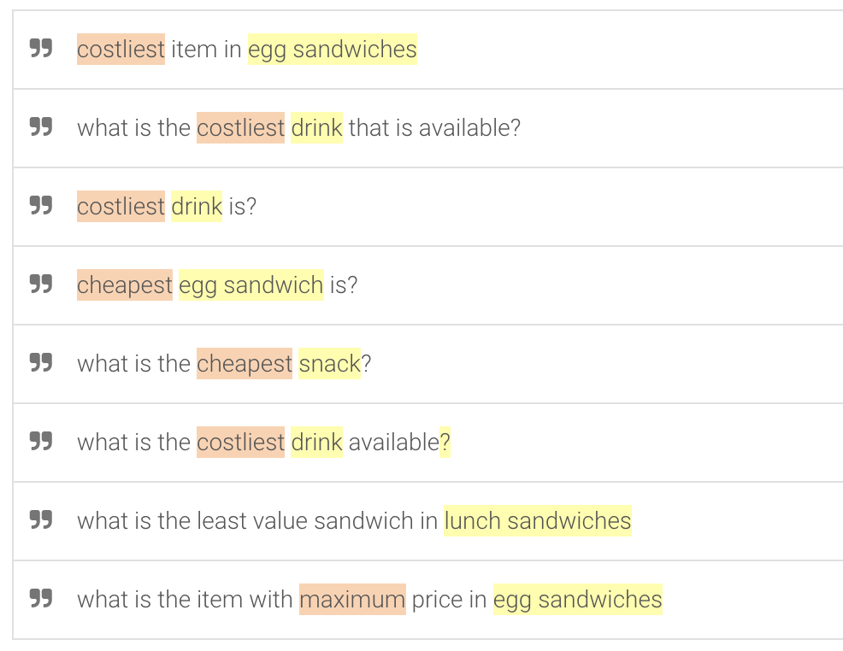
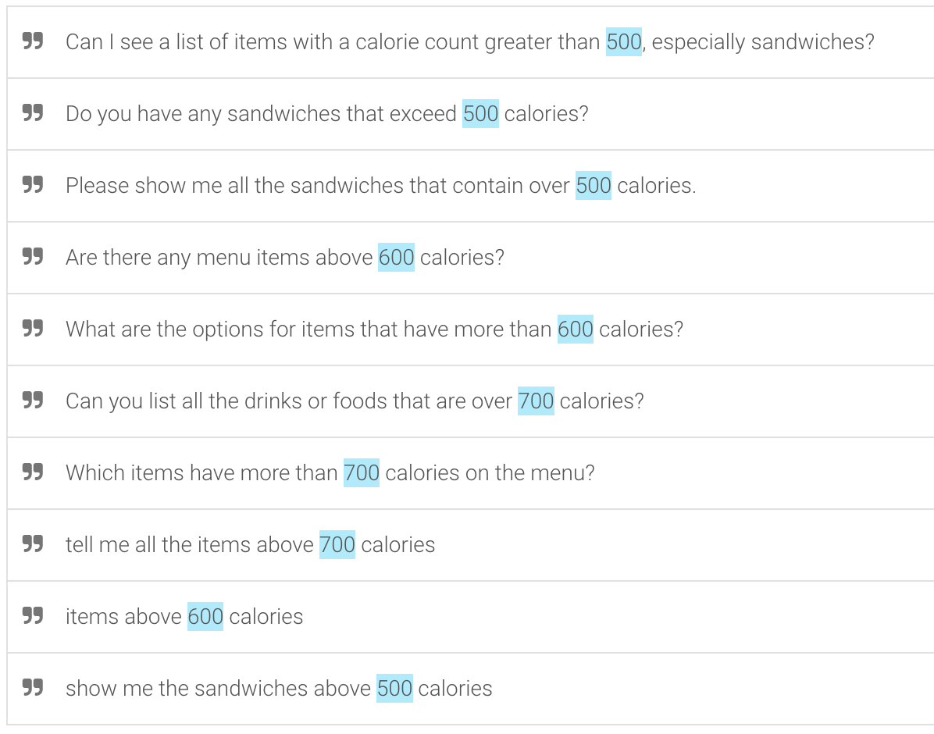
Challenges and Solutions
Limited Training Data:
Issue: Limited training data caused frequent unrecognized queries.
Solution: Added synonyms, alternative phrases, and new intents in Dialogflow.
Free Dialogflow console Drawbacks: Simpler Analytics and Insights
Issue: Limited conversational analytics, with basic performance metrics like intent
matching and user queries.
Solution: Paid version provides detailed analytics, including advanced user journey mapping,
flow visualization, and custom reporting.

Slide 29
Challenges and Solutions
Free Dialogflow console Drawbacks- Lesser Scalability for High-Traffic Applications
Issue: Not suitable for applications requiring high concurrent user handling due to limitations
on request volume and latency.
Solution: Paid version is built for large-scale enterprise applications with better concurrency
management and reduced latency.
Free Dialogflow console Drawbacks- No Enterprise Security Features
Issue: Lacks advanced security features such as data residency options, encryption control,
and compliance certifications for industries like healthcare or finance.
Solution: Paid version offers enterprise-grade security and compliance (e.g., GDPR, HIPAA)
and more robust data handling features

Slide 30

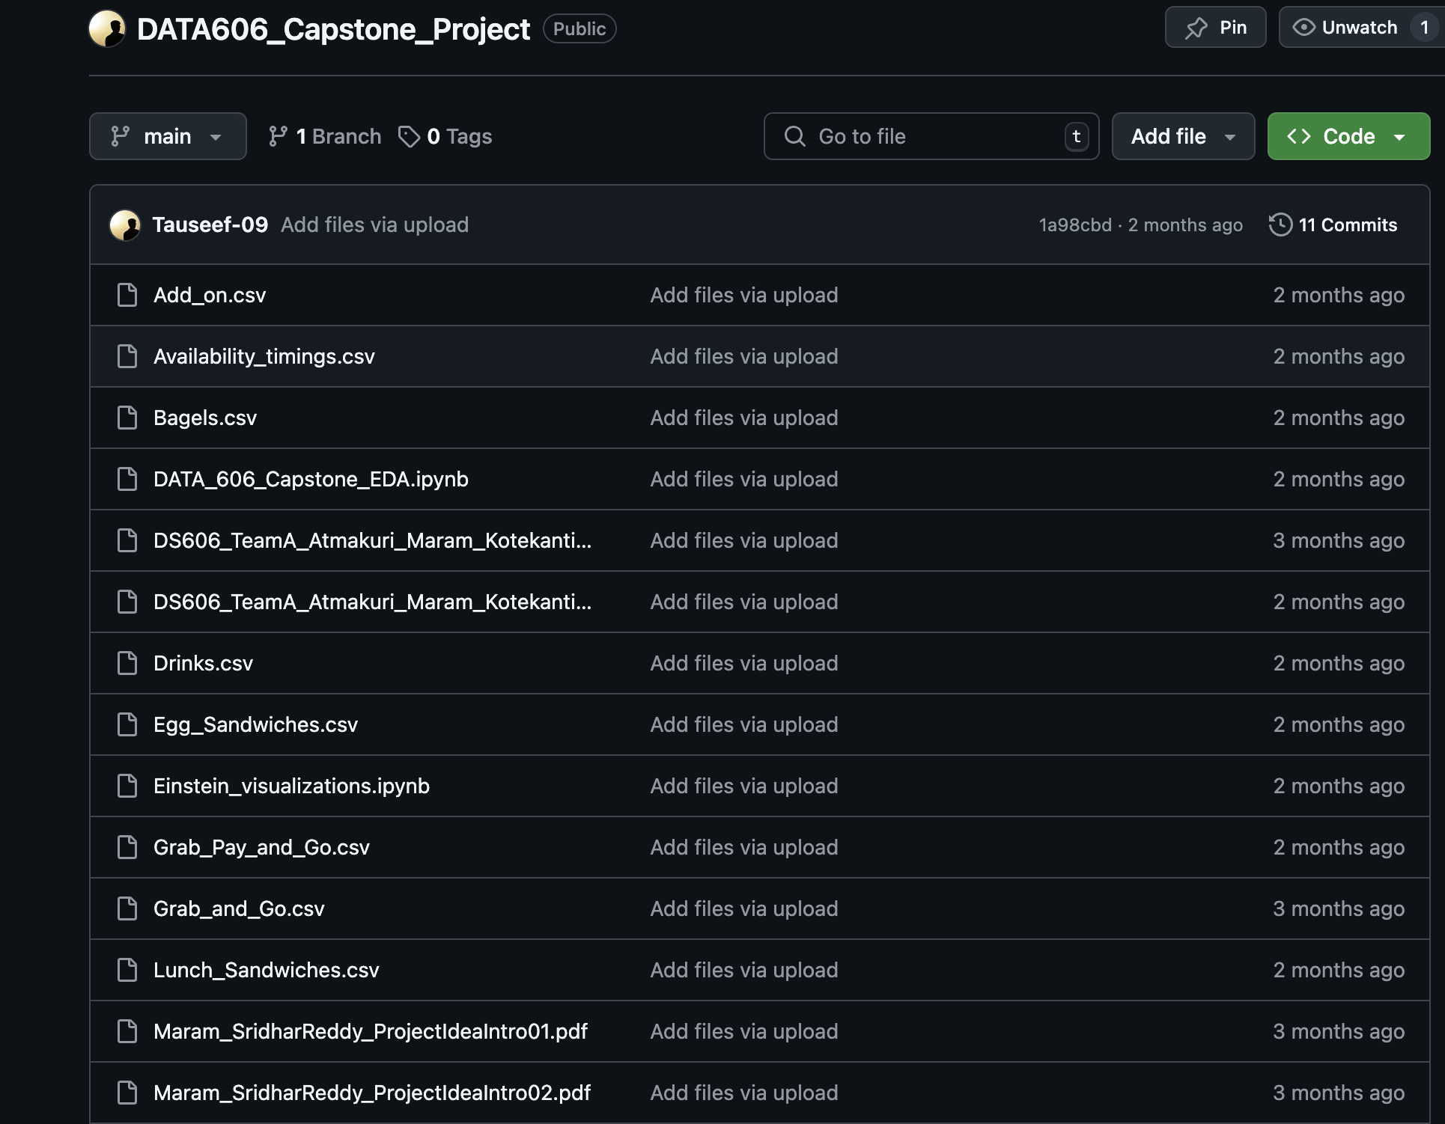
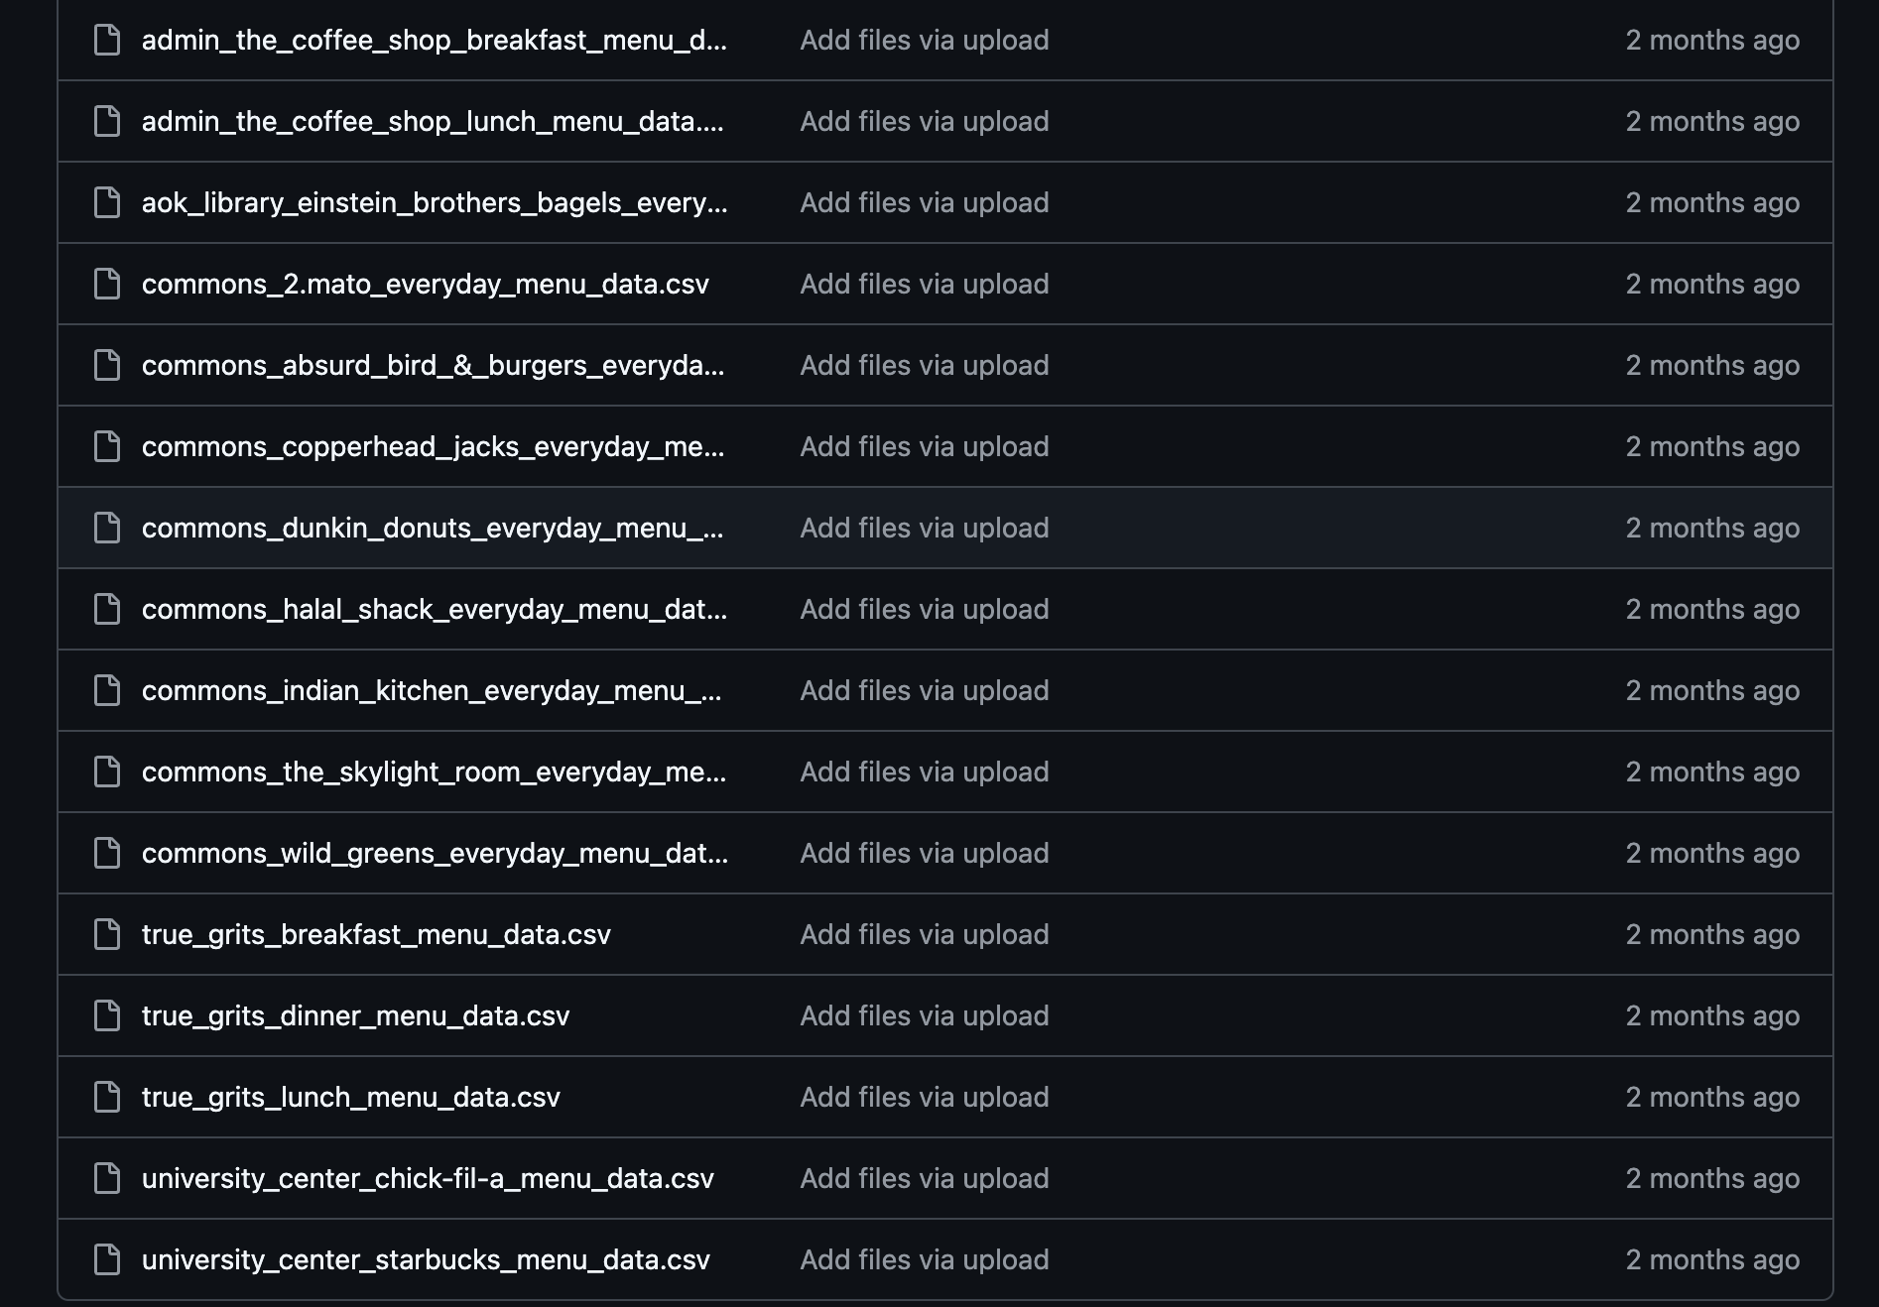
Github Page Overview
Repository Link:
https://github.com/Tauseef-09/DATA606_Capstone_Project
Snapshot:

Slide 31

Conclusion
Project Summary: The food court chatbot successfully automates menu inquiries, price checks, and nutritional information retrieval, enhancing the customer experience and reducing workload for staff.
Impact: By leveraging technologies like Dialogflow, FastAPI, and MySQL, the chatbot demonstrates how AI can simplify food ordering processes in real-time.
Future Directions: Expanding the chatbot's capabilities, such as personalized meal recommendations, order tracking, and multilingual support, will make it more adaptable and impactful across diverse environments.

Slide 32

References
GitHub: [Mr. Hungry Chatbot](https://github.com/AhmadYasser1/Food-Recommending-Chatbot)
GitHub: [Kayo AI Chatbot](https://github.com/yenxuan1381/food-ordering-chatbot-using-ai)

Slide 33


